Slide 1
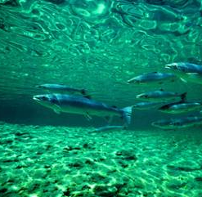
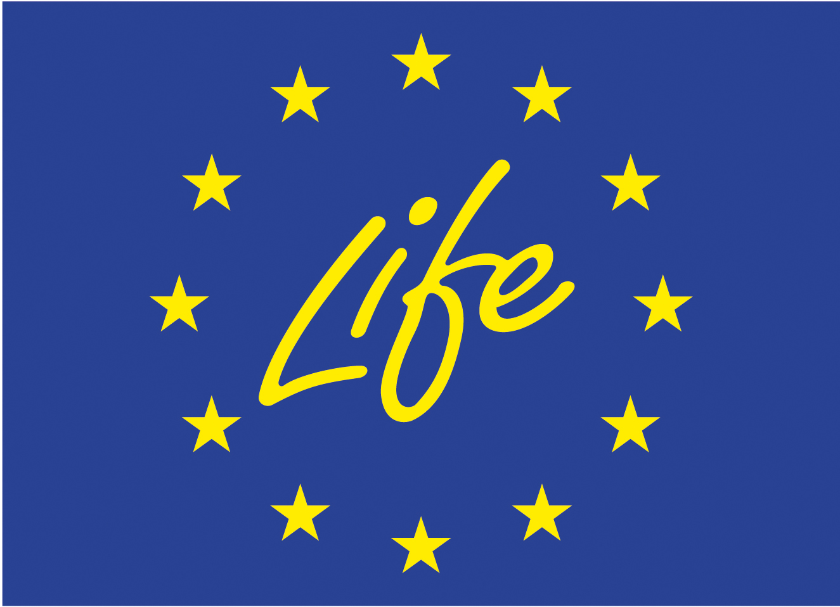
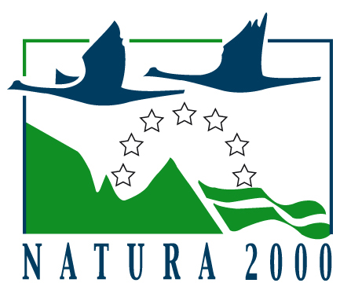
Restoration Measures for Freshwater Fish
By Dr Lynne Barratt
(NEEMO)

Slide 2
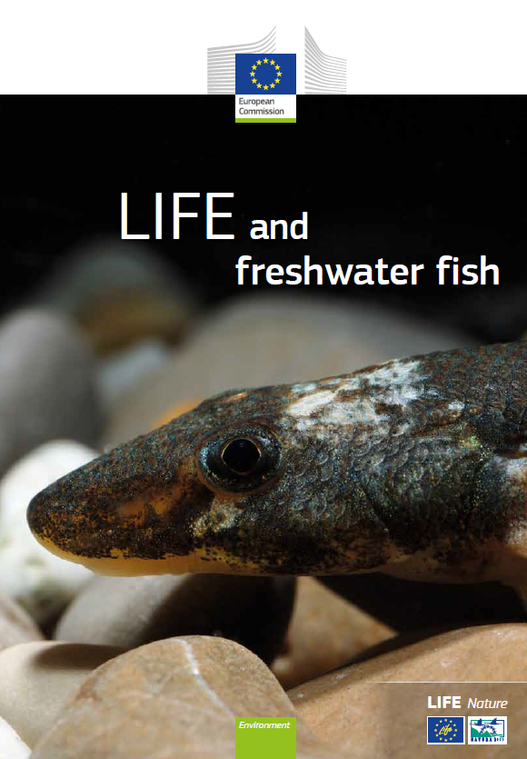
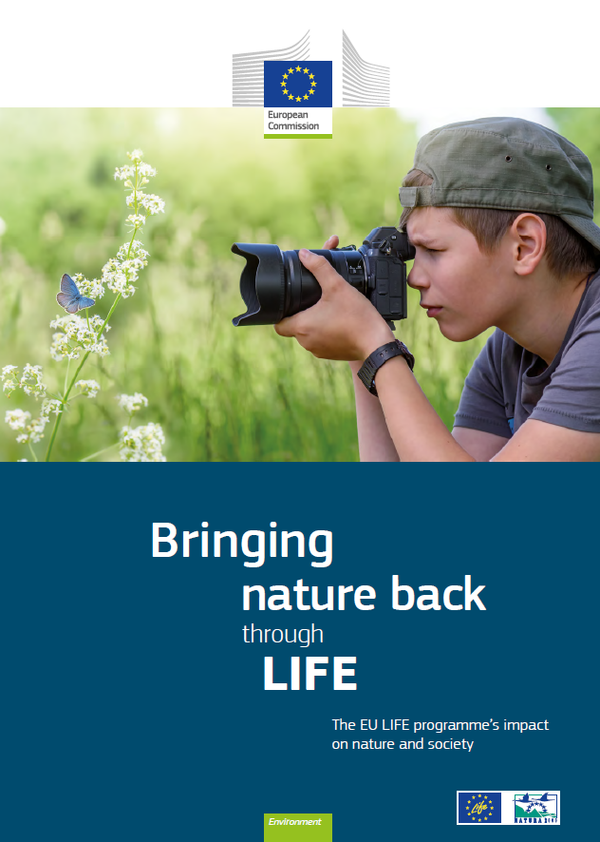
LIFE and Freshwater Fishes
Notes:
Life and Freshwater Fish published in 2015 provided a synthesis of all LIFE projects from 1992 through to 2013 which had a connection to fish.

Slide 3
What is lesser known?
Species No of LIFE
projects
Notes:
Between 1992 and 2018, LIFE invested €150 million in fish protection and targeted 64 species of freshwater fish, six of which now show an improving trend. The latest Article 17 reporting indicates several direct links between the LIFE programme and conservation status maintenance or improvement of freshwater fish
species. Interestingly, the majority of these success stories have involved multiple projects within a country targeting the same species.

Slide 4
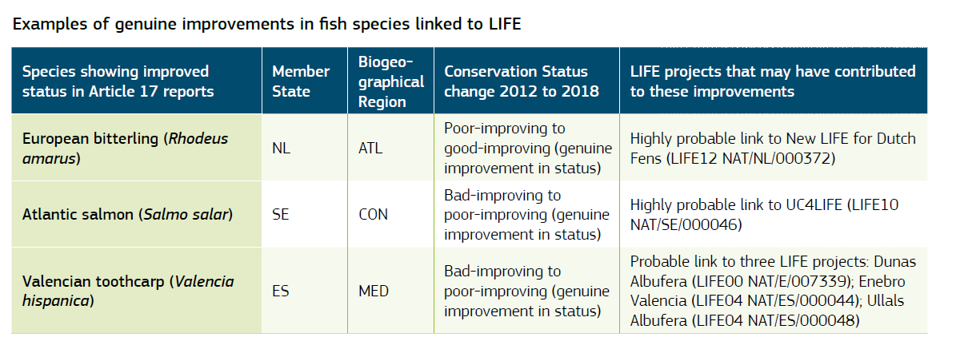
Improved conservation status

Slide 5
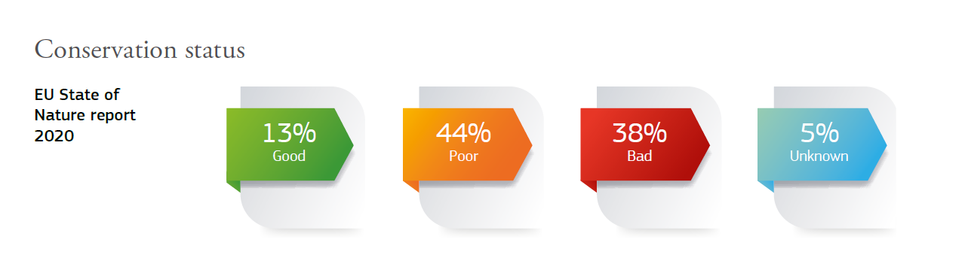
Conservation Status Trends

Slide 6
Conservation Measures
Notes:
18 projects between 2012 and 2018 – some still open – list appears in the project background document – not included projects prior as these are covered in the LIFE and Freshwater Fishes publication – more recent projects have not yet had main results so not included. All these projects are targeting fish species but there are many others targeting biodiversity or WFD which also adopt some of these types of intervention and will inevitably be beneficial for fish species.

Slide 7
Restricted Habitats
Remove coastal infrastructure
Restored and revegetated dunes
Restored network of temporary ponds and marshland
Reintroduced the tooth carp
Valencian toothcarp
Gizani
Establishing new pond features designed as refuges to protect from drought
Installation of automatic water pumps.
Solar powered water quality monitoring devices.
Public awareness significantly increased.
Also benefitted freshwater turtles and eels
Range and population status now reported as favourable.
Notes:
The Valencian toothcarp (Valencia hispanica), a critically endangered species. According to the IUCN, the species underwent a population decline of more than 80% between 1996 and 2006 as a result of habitat destruction for urbanisation and agriculture, water extraction and pollution, and the introduction of predatory invasive alien fish species. Now there are seven remaining populations (six in Valencia and one in Catalonia). They are largely isolated and genetically distinct. The species mainly occupies small coastal freshwater bodies formed from upwellings of spring water and coastal lagoons with dense vegetation.
Three projects focused on restoring the priority habitats that support this species may have played a role in its improved conservation status from bad to poor. The first project was in 2000, Dunas Albufera (LIFE00 NAT/E/007339), which removed coastal infrastructure, restored and revegetated the dunes and reintroduced the Valencian toothcarp. Two further projects in the same location were financed in 2004. Enebro Valencia (LIFE04 NAT/ES/000044) restored a large network of temporary ponds and introduced the Valencian toothcarp in these new locations. Finally, Ullais Albufera (LIFE04 NAT/ES/000048) recovered a 6 ha area of marchland and restored optimum conditions.
Launched in 1998, the Ladigesocypris Ghigii project (LIFE98 NAT/GR/005279) was the Greek authorities’ first attempt to conserve an endemic, endangered, freshwater fish species, the gizani (Ladigesocypris ghigii). A combination of threats, including water shortages during droughts, as well as water pollution and habitat loss linked to human development, had all impacted adversely on the gizani. Extinction was a real risk for the small and inconspicuous fish in some parts of its territorial range prior to the project taking effect. A major concern was the lack of knowledge about the species’ conservation needs, so early work for the LIFE team involved building sufficient scientific understanding of how to manage the remaining populations.

Slide 8
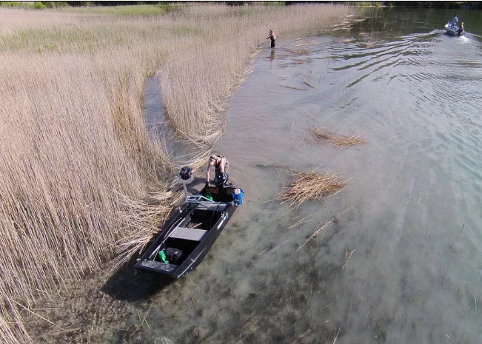
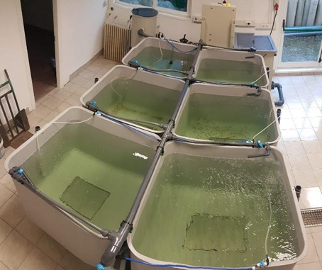
Lakes
Restoration work on 36 streams removing migratory barriers
Improved land use to reduce pollution
Improved sewage systems to reduce load to lakes (eutrophication)
Cut reeds to improve water flow
Introduced protected area to lakes
Italian nase amongst the targets threatened by habitat decline and competition from introduced species
Key actions in IdroLIFE were establishing hatchery conditions for target species
Released into lakes – awaiting final monitoring report
Notes:
Triple Lakes in Sweden
In some parts of the project area's lakes, reed belts have started to spread. Sometimes the reeds can mean a deterioration of the flow of water and when the water speed is reduced, small particles stop and settle on the bottom. In this way, the reeds can spread further and the problem worsens. Reeds can be controlled by cutting them below the water level, this may need to be repeated a couple of times per growing season for a few years. In the project, we have struck reeds in two places. In the outlet of Locknesjön and the outlet of Bensjön. The measures have been carried out by the fisheries conservation areas concerned and the County Board. Othe rmeasures have been taken to improve water quality. Landscape scale project to create new spawning grounds for grayling and bullhead as a response to climate change. Restoration work undertaken in 36 streams removing migratory barriers, establishing fish passes (including various actions for easing road culverts), and creating spawning grounds. Actions that decreased the impacts from land-use and improved conditions for target species and increased their ability to adapt to climate change. Restored in stream hydromophology adding 235,000m2 of physically functioning bottom substrate and releaseing 70km of river for migratory species. Improvements in sewage load to lakes and establishment of a water protection area for part of one lake.
LIFE15 NAT/IT/000823
IdroLIFE Among other things improved conditions for a number of species including Italian nase which is an endangered species of cyprinid inhabiting lakes in Italy Slovenia and is threatened by habitats decline and introduced species. .

Slide 9
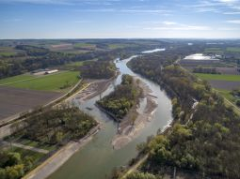
Rivers and streams
Dividing the river to reduce the flow
1.650 m of restored, structured river banks
1,500 m of reinforced river banks removed
3,050 m new gravel and sand banks
4,490 m structured river banks
Purchase of 2.8 ha of agriculture and forestry land
Removal of 10 obstacles to fish migration
Facilitated passage through 2 other obstacles
Naturalised 1.5 ha of industrial ruins
Completed in-stream restoration through woody debris
Good results for the Alis shad – final report under assessment
Notes:
LIFE14 NAT/DE/000278
LIFE Flusserlebnis Isar: Purchase of 2.8 ha of agricultural and forestry land; Some 1 650 m of restored, structured river banks, 1 500 m river banks with removed bank enforcement, 3 050 m new gravel and sand banks, and 4 490 m structured river banks; An increase of the populations of huchen (Hucho hucho), asp (Aspius aspius), streber (Zingel streber), pigo (Rutilus pigus) and white-finned gudgeon (Gobio albipinnatus); Some 2 600 m of semi-natural and ecologically improved alluvial water bodies (habitat type 3150) and improved habitats for the European weatherfish (Misgurnus fossilis).
LIFE14 NAT/ES/000186
LIFE IrekiBAI achieved its objective of improving the conservation status of river habitats and species of the Habitats Directive in Natura 2000 sites in the Bidasoa and Oria river basins in Spain. The project team removed 10 obstacles to animal movement, facilitated passage through two other obstacles, removed dams over more than 7 km, and naturalised 1.5 ha of industrial ruins. Good results for Atlantic salmon, indicators for Alis shad, lamprey and Cottus need more time to show recovery.

Slide 10
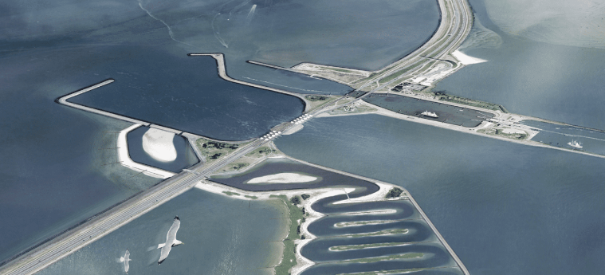
Transitional Waters
The majority of the NL coastline is controlled by barriers
Fish migration in transitional waters is challenging
Innovative 1.5 km fish migration river from the Wadden Sea to the Ijsselmeer via a permanent barrier
Connection will stimulate the natural attraction flow of the river
Plenty of time for acclimation through the 1.5 km channel
Work has already begun!
Notes:
LIFE16 NAT/NL/000155
Fish migration & BirdLIFE: Project still underway. Technical design has been approved for innovative 1.5 km fish migration river from Wadden Sea to the Ijsselmeer via a permanent barrier. The connection will simulate the natural attraction flow of the river.

