Slide 1
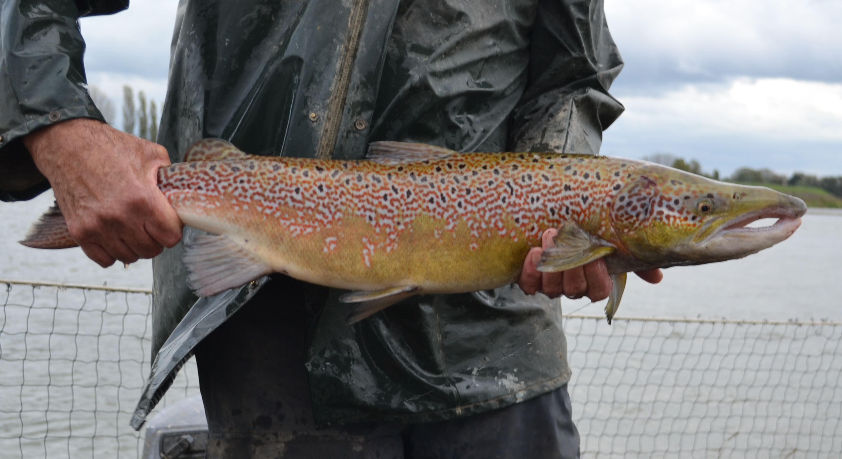
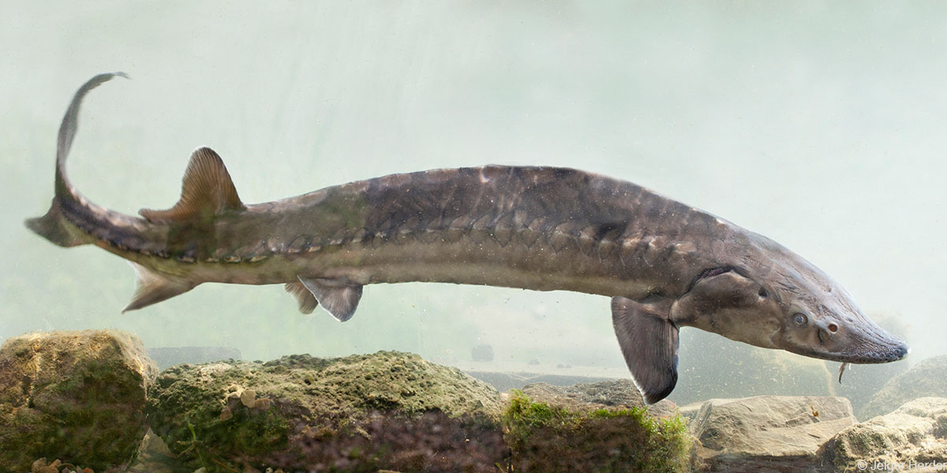
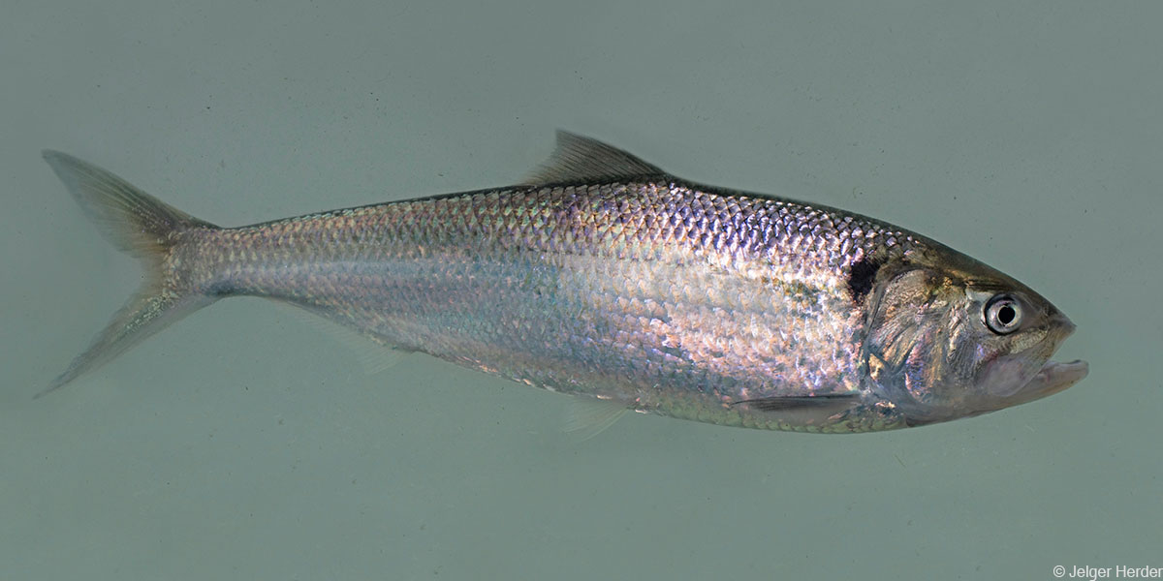
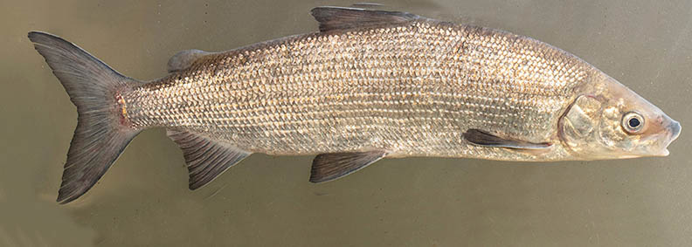
Research, trends and fisheries impact on Annex V species in the The Netherlands
Freshwater fishes in the context of the EU Biodiversity Strategy
24-11-2022 Jacco van Rijssel
©Jelger Herder
©Jelger Herder
©Jelger Herder

Slide 2
Outline
Monitoring overview
Trends/research per species
Causes of (recent) decline
Conclusions
“Annex V species: Member States must ensure that their exploitation and taking in the wild is compatible with maintaining them in a favourable conservation status.”

Slide 3
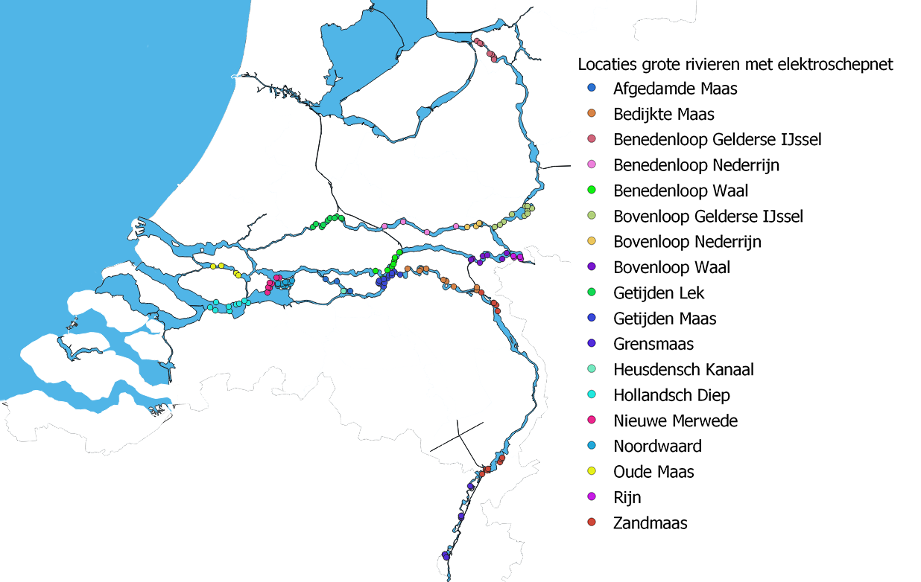
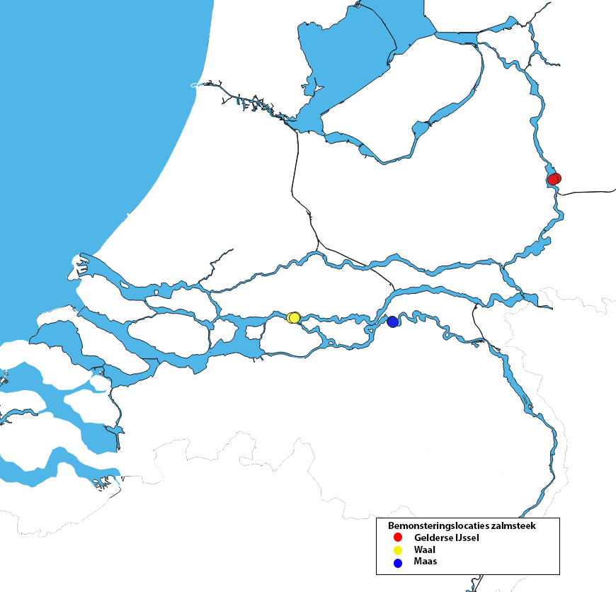
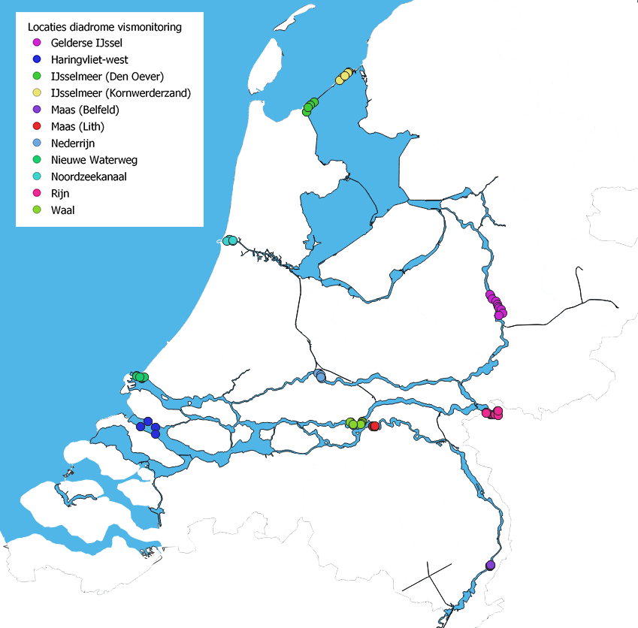
Freshwater monitoring in The Netherlands
Electric dipping net
Salmon fykes
Diadromous fish fykes

Slide 4
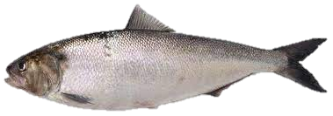
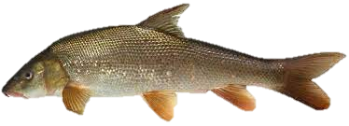
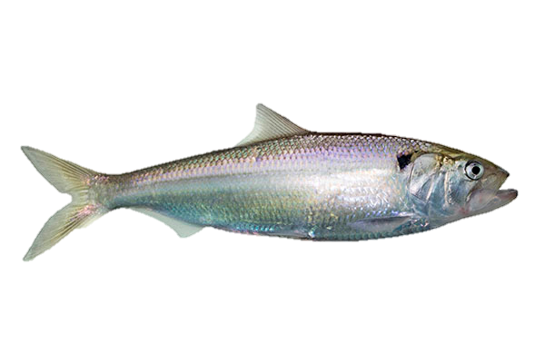
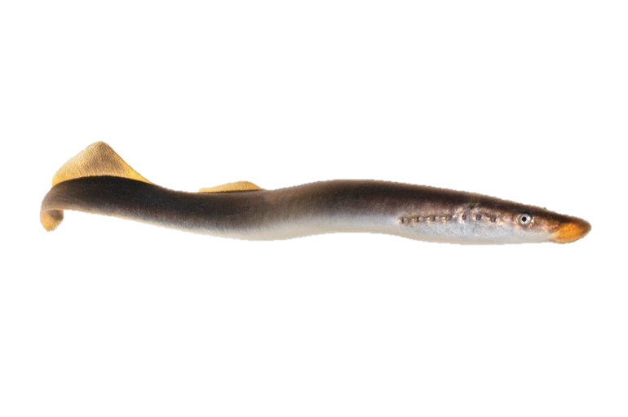
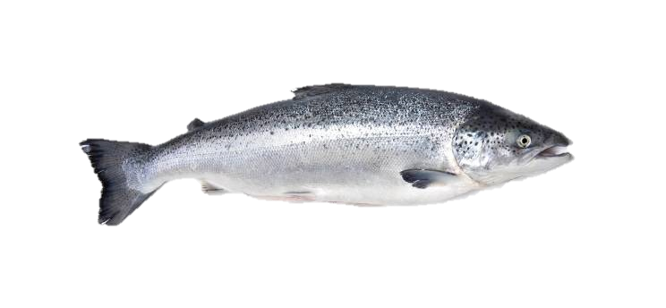
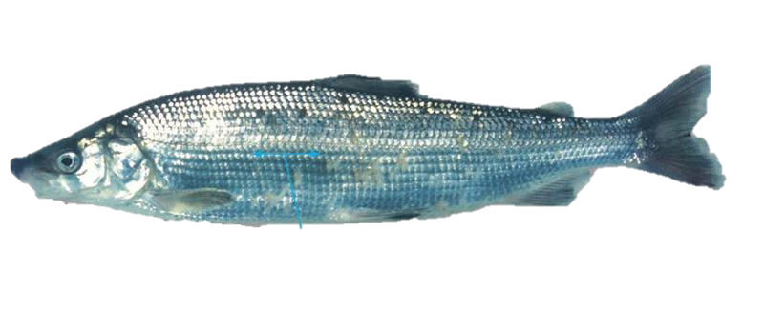
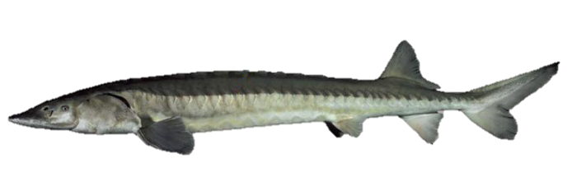
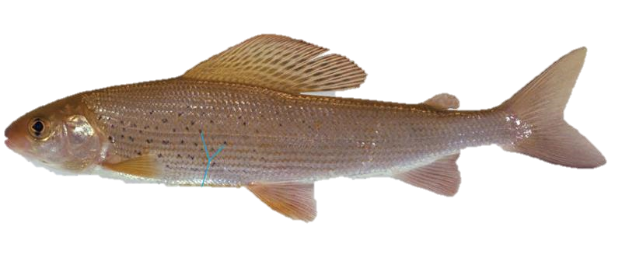
Annex V fish species
Allis shad (Alosa alosa)
European barbel (Barbus barbus)
Twaite shad (Alosa fallax)
  European river lamprey (Lampetra fluviatilis)
  Atlantic salmon (Salmo salar)
  Houting (Coregonus .......)
Photos: Sportvisserij Nederland, Jelger Herder
  European grayling (Thymallus thymallus)
  European sturgeon (Acipenser sturio)

Slide 5
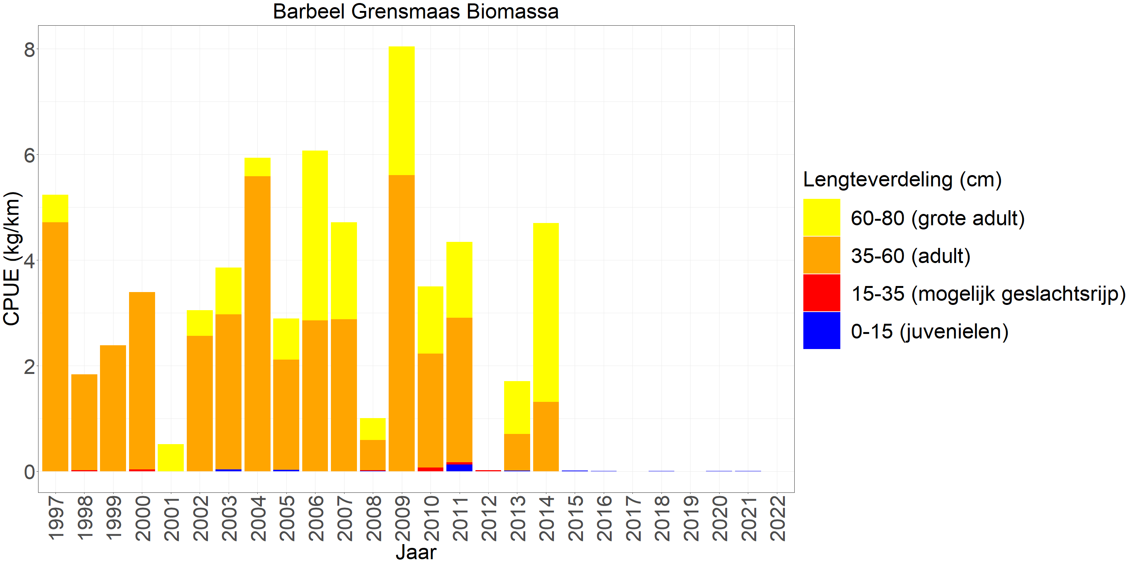
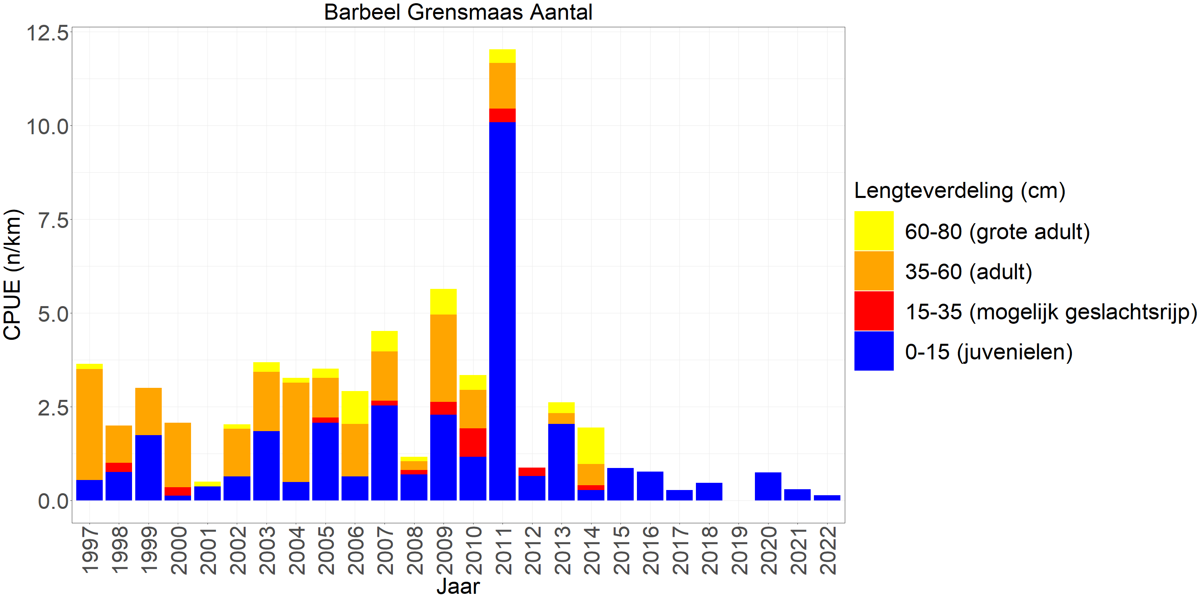
European barbel (Barbus barbus)
Annex II,V

Slide 6
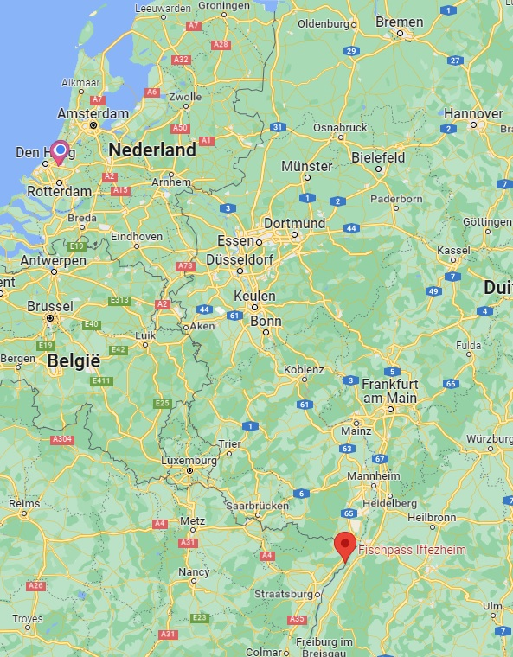
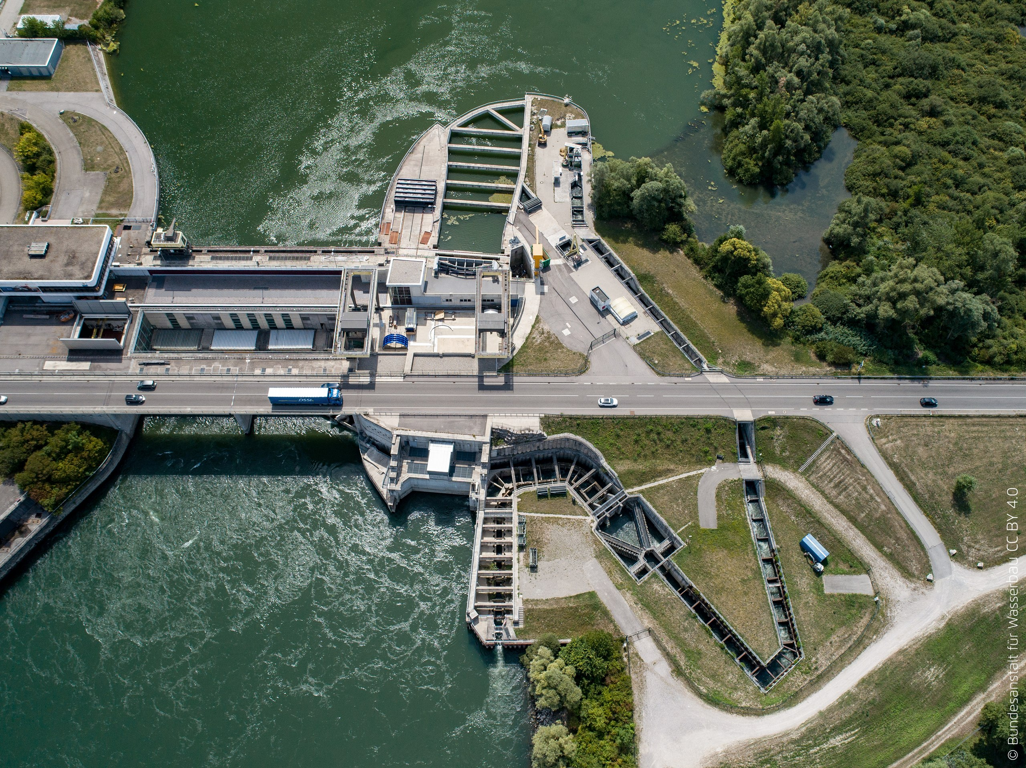
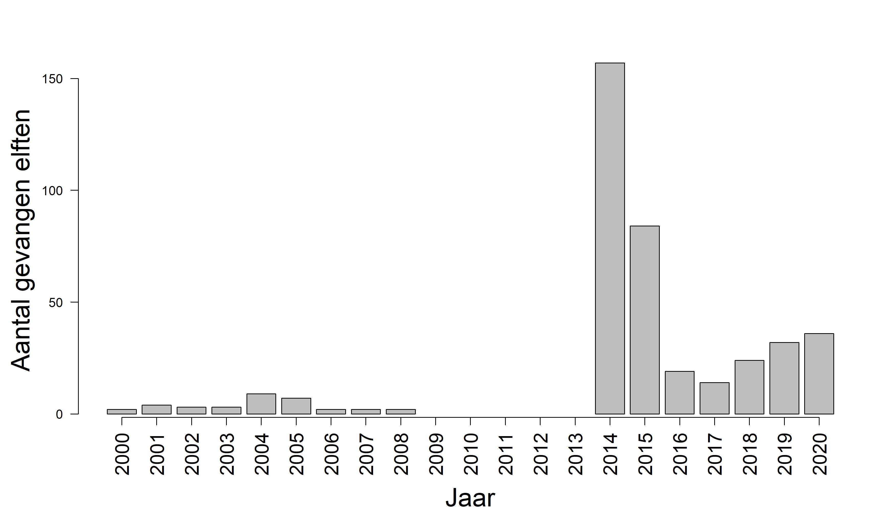
Allis shad (Alosa alosa)
Annex II,V

Slide 7
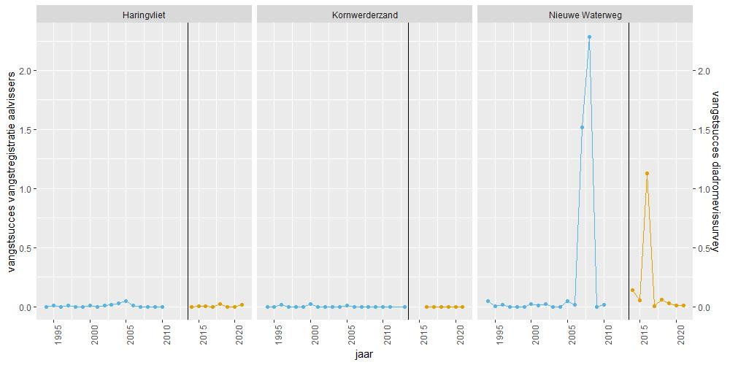
Twaite shad (Alosa fallax)
Annex II,V

Slide 8
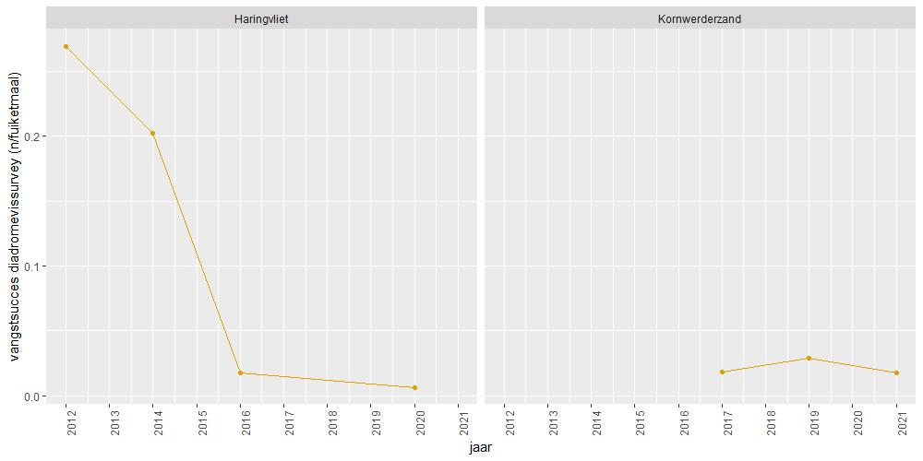
European river lamprey (Lampetra fluviatilis)
Annex II,V

Slide 9
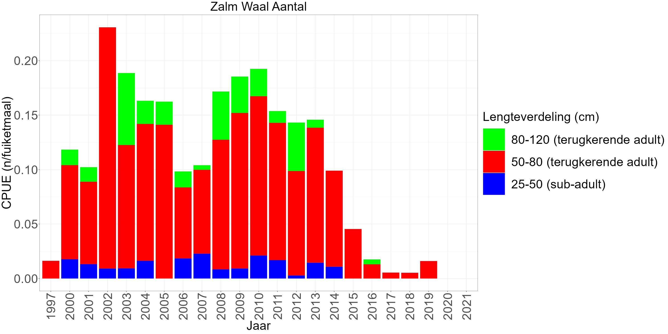
Atlantic salmon(Salmo salar)
Annex II,V, annex III (Bern Convention)

Slide 10
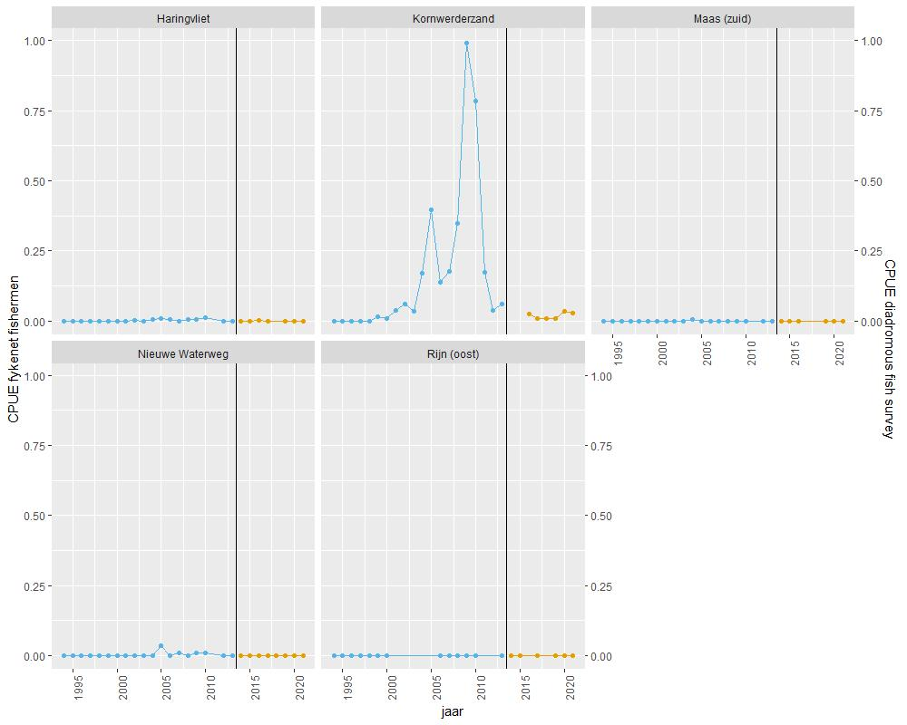
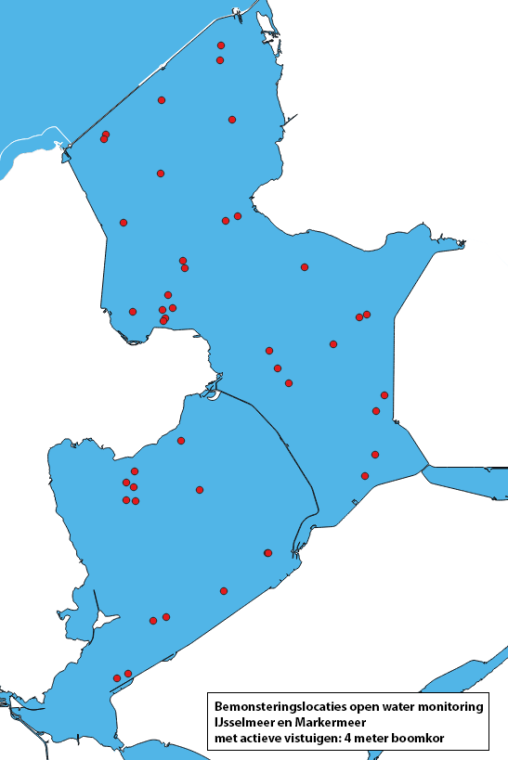
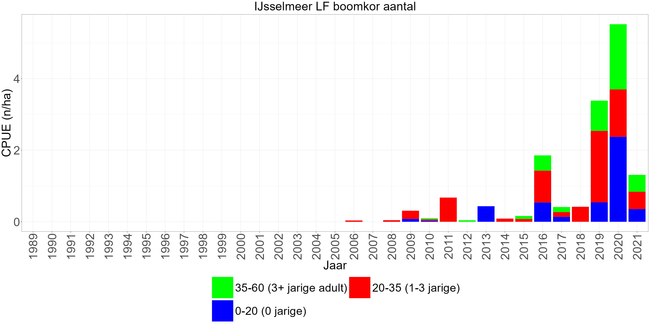
North Sea Houting (Coregonus oxyrinchus)
Annex II, IV, V? Annex III (Bern Convention)
Coregonus oxyrinchus is genetically not distinct from Coregonus lavaretus
So, North Sea Houting is the same as the “European whitefish”
Annex should be adjusted accordingly after scientific publication (Kroes et al. in preparation).

Slide 11
European grayling (Thymallus thymallus)
Annex V, annex III (Bern Convention)
Extinct in the Netherlands since 1885 (river “de Geul”, Limburg)
River damming, increase of silt, pollution, unnatural discharge fluctuations and (spawning) habitat decrease
Unsuccessful occasional stocking in
creeks and rivers (Keersop and Roer)
in the 1990s and 2000s
Chances of reoccurrence are slim,
habitat needs to be restored

Slide 12
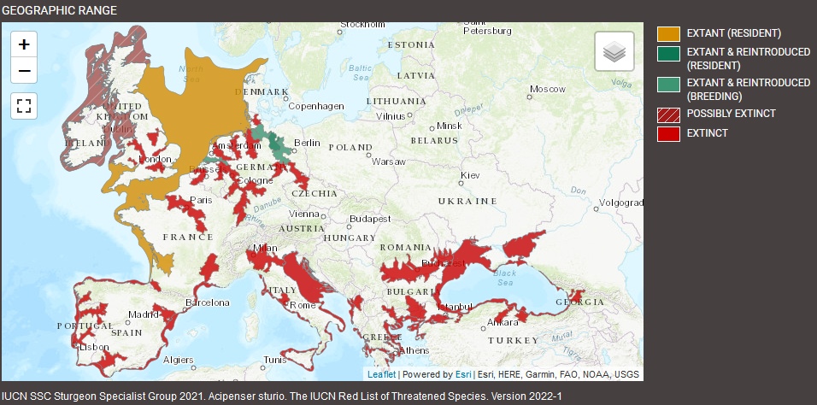
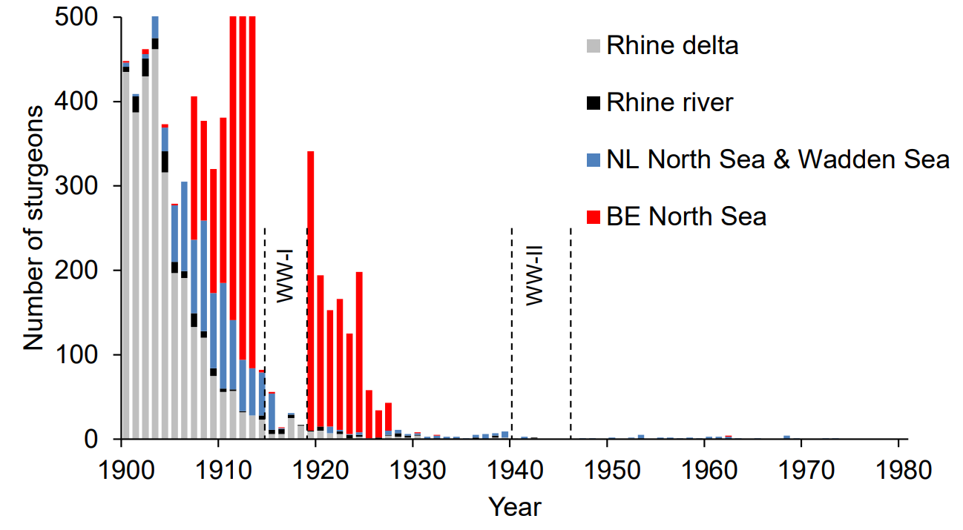
European sturgeon (Acipenser sturio)
Annex II, IV, Annex II (Bern Convention)
Figures courtesy of Niels Brevé, Brevé et al. (2022)

Slide 13
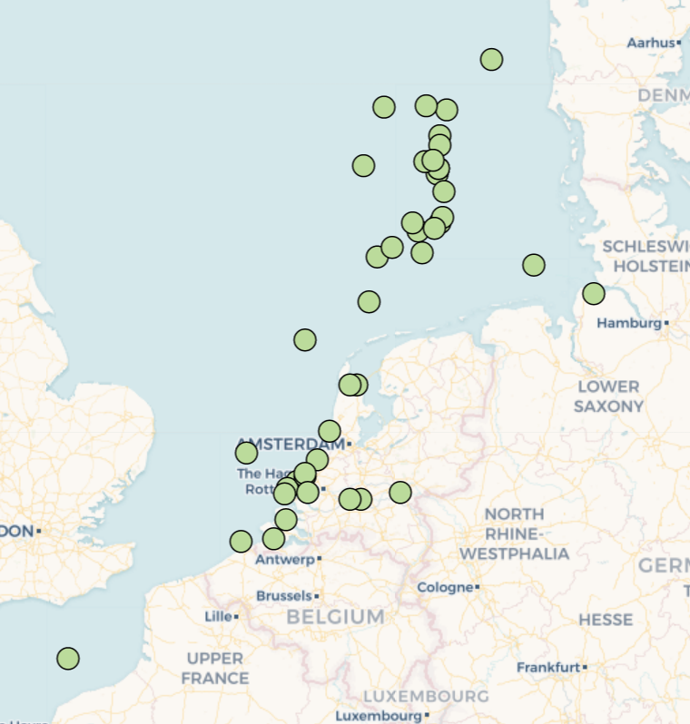
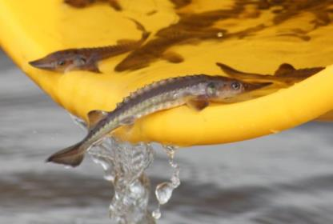
European sturgeon (Acipenser sturio)
Annex II, IV, Annex II (Bern Convention)
2012, 2015 & 2023 experimental stocking of tagged juveniles in the Rhine
Figures courtesy of Niels Brevé, Brevé et al. (2022)

Slide 14
Causes for decline or non recovery
Historically: overfishing, dams, loss of (spawning)habitat, pollution
Causes for recent decline/non recovery
  Short answer: We don’t know
    Atlantic salmon → IUU fishing?, climate change?, too little spawning habitat reachable? European catfish/cormorant predation? Genetically unsuitable stockings?
    European barbel → unnatural fluctuations discharge?, European catfish predation?, invasive species?
Bycatch of commerical fisheries seems not a (major) issue

Slide 15
Commercial fisheries impact (yearly bycatch)
Bycatch 1000s-100,000s in shrimp trawl fishery North Sea (“non-Dutch” juveniles), dependent on stock size, low survival
Twaite shad (Alosa fallax)
0-few
Allis shad (Alosa alosa)
100s-1000s in fyke fishery Lake IJsselmeer, high survival
  European river lamprey (Lampetra fluviatilis)
No information, probably 10s-100s in gill net/seine fishery in rivers (guestimate)
European barbel (Barbus barbus)
van Rijssel et al. 2019

Slide 16
Commercial fisheries impact (yearly bycatch)
Bycatch 10,000s gill net fishery Lake IJsselmeer, low survival, despite that, population seems to increase still
  North Sea Houting (Coregonus oxyrinchus)
10s-100s, fyke fishery in Dutch Delta
  Atlantic salmon (Salmo salar)
No information, probably 10s-100s in trawl fishery North Sea
  European sturgeon (Acipenser sturio)
No information, extinct, probably 0
  European grayling (Thymallus thymallus)
van Rijssel et al. 2019

Slide 17
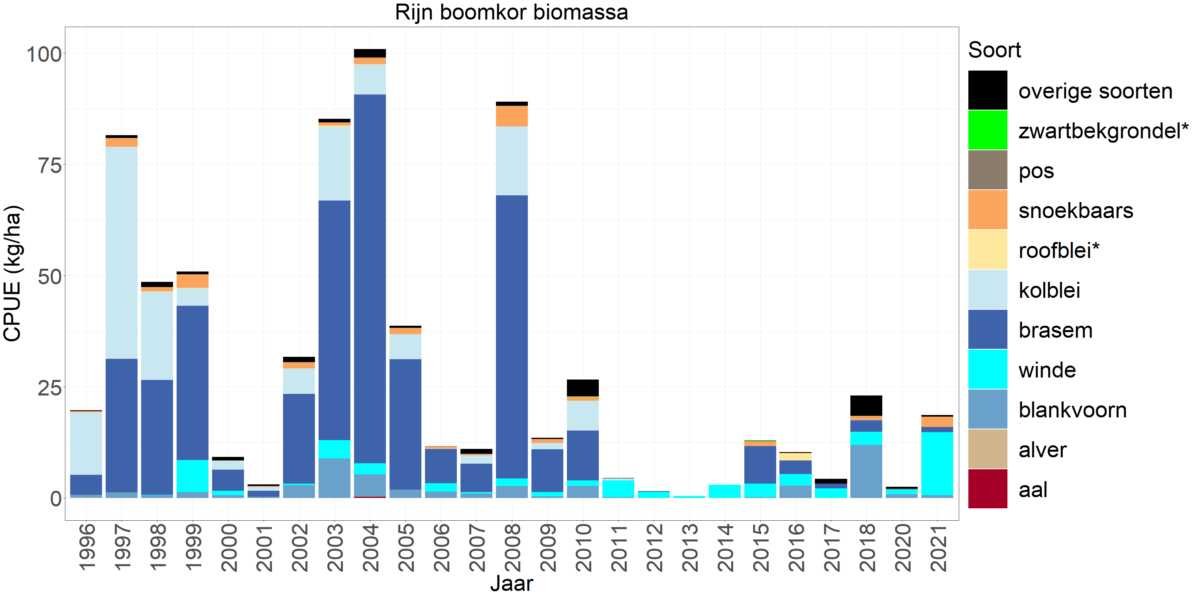
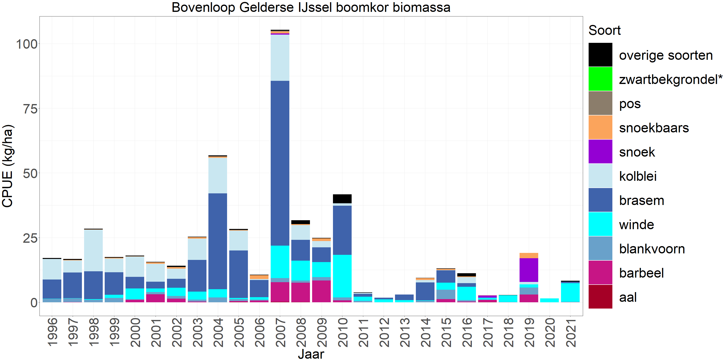
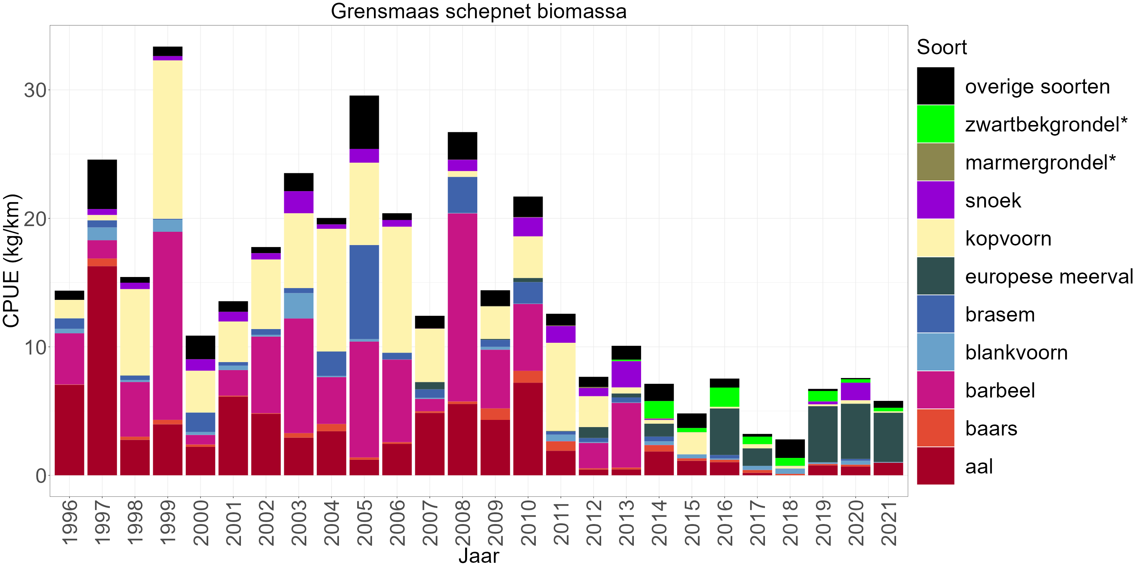
Collapse of eurytopic & rheophilic species same period
Rhine
IJssel
Meuse

Slide 18
Conclusions
All annex V species protected by complementary annexes
Monitoring needs improvement
Collaboration/information exchange between countries vital, common cause of decline?
Specific hypothesis based research needed
Riversystem recovery measures and stockings need to be combined with research on (lack of) success.

Slide 19
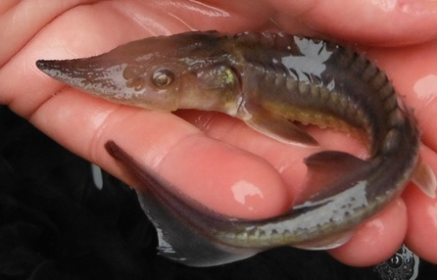
Thank you!
Questions?
Photo: Vanessa Lauronce (MIGADO)

