Slide 1
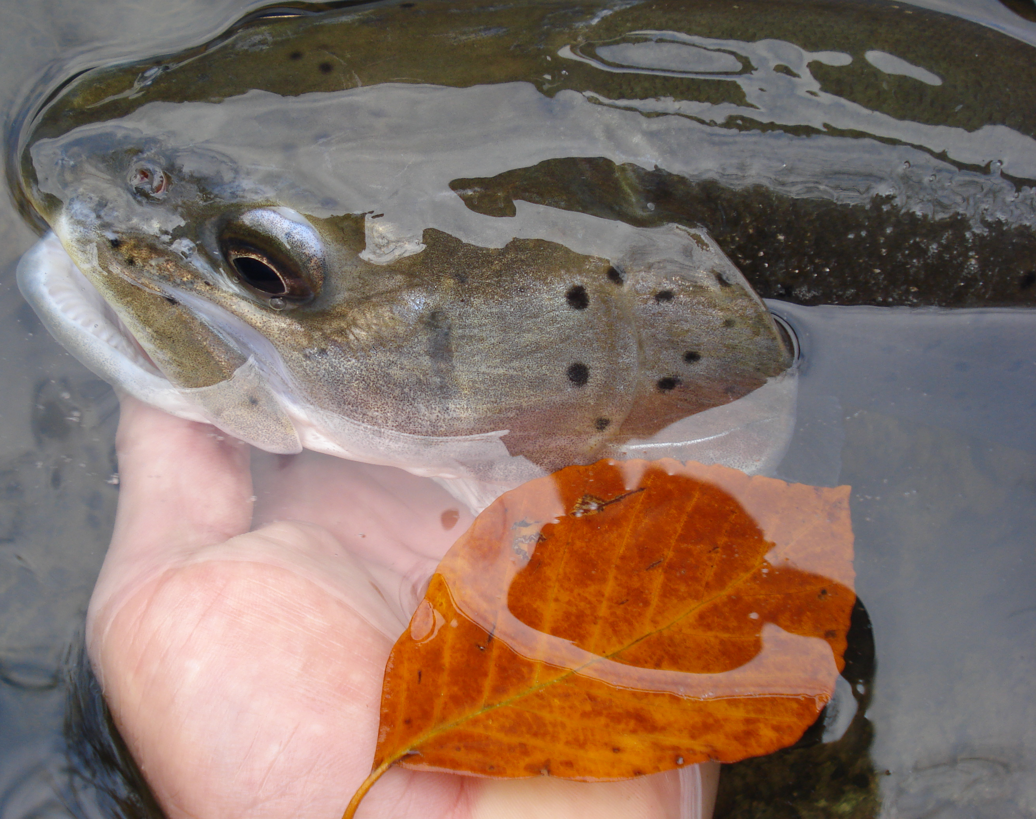
Is recreational fishing compatible with strict site protection?
Prof. Marina Piria
University of Zagreb Faculty of Agriculture, Croatia
E-mail: mpiria@agr.hr
Member of EIFAAC/FAO

Slide 2
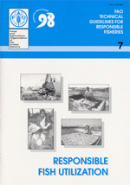
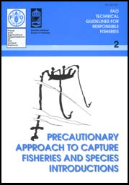
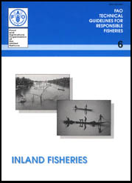
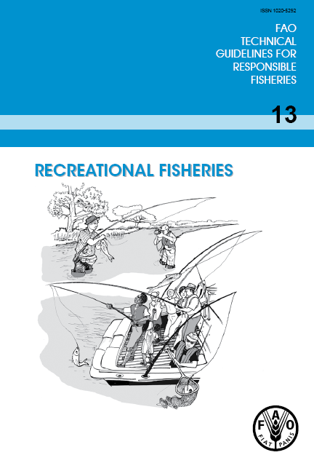
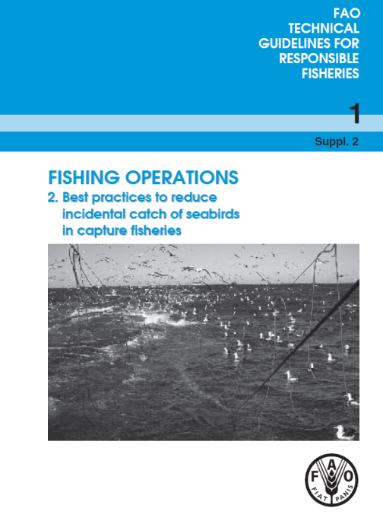
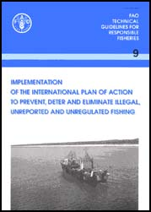
EIFAAC/FAO ACTIVITIES
  EIFAC Code of Practice for Recreational Fisheries by the 25th session of EIFAC in Antalya, Turkey, in 2008
  Technical guidance:
  Shall guide policy and decision makers and others involved in policy and technical interventions in recreational fisheries.
  Shall contribute to sustaining recreational fisheries in the face of expanding threats and unsustainable fishing practices.

Slide 3
Introduction
Arlinghaus, R. and Cooke, S.J. (2009). Recreational Fisheries: Socioeconomic Importance, Conservation Issues and Management Challenges. In Recreational Hunting, Conservation and Rural Livelihoods (eds B. Dickson, J. Hutton and W.M. Adams). https://doi.org/10.1002/9781444303179.ch3
Conservation management & objectives of fisheries management - protecting and enhancing biodiversity and habitats
key goal of fisheries management -maintain and enhance exploited populations towards biomass levels that produce acceptable services to humans
The difference is the scope of the targeted taxa:
  conservation -species of concern (e.g.threatened species) or protection of vulnerable habitats,
  fisheries management - exploited fish species, rarely directs specific attention towards other taxa
the conservation-conscious recreational fishing community represents one of the greatest potential forces for the conservation of aquatic biodiversity
Notes:
Conservation management shares similarities with the objectives of fisheries management related to protecting and enhancing biodiversity and habitats
one key goal of fisheries management is to maintain and enhance exploited populations towards biomass levels that produce acceptable services to humans
The difference between conservation and fisheries management is often the scope of the targeted taxa.
conservation typically targets species of concern (e.g.threatened species) or protection of vulnerable habitats,
fisheries management typically aims at exploited fish species, sometimes also including “non-game” fishes but rarely directs specific attention towards other taxa than those that are exploited or support the exploited species (e.g., prey fish for targeted predators).
the conservation-conscious recreational fishing community represents one of the greatest potential forces for the conservation of aquatic biodiversity

Slide 4
Conflicts recreational fishery vs conservation
uncertainty is the biological impact of recreational fishing the ecosystem and biodiversity
AM approach - respond to the demands of the risk-averse ecosystem approach
Support for conservation by fisheries stakeholders is typically high as long as the chosen conservation actions involve the continued use of the species or population of interests.
assigning protected areas with partial or full removal of capture fisheries from certain zones are a continuous source of conflict among conservation and fisheries
conflicts exist when fisheries management actions constrain access to the resource
a net benefit to fisheries stemming from no-take protected areas can only be expected if the catch of fish is increased outside the boundaries of protected areas relative to the situation before the implementation of the measure
Notes:
Support for conservation by fisheries stakeholders is typically high as long as the chosen conservation actions involve the continued use of the species or population of interests.
conflicts exist when fisheries management actions constrain access to the resource
conservation and fisheries stakeholders tend to intensively debate the proper tools to achieve their goals.
assigning protected areas with partial or full removal of capture fisheries from certain zones are a continuous source of conflict among conservation and fisheries
This is because a net benefit to fisheries stemming from no-take protected areas can only be expected if the catch of fish is increased outside the boundaries of protected areas relative to the situation before the implementation of the measure
The implementation of protected areas, and their effectiveness continues to be controversial, specifically where a central authority is the decision-maker

Slide 5
Conservation issues by recreational fishers

Slide 8
Benefits from fishery
Improvement of local fish biodiversity in gravel pit lakes
Gravel pit lakes -lentic water bodies created through human mining of sand, clay, gravel and other natural resources
recreational-fisheries management fostered local fish species diversity and the establishment of fish communities that are similar to those present in managed natural lakes of similar environmental characteristics in relation to size, depth and eutrophication
unmanaged gravel pit lakes were also affected by human-mediated colonization, presumably by illegal fish releases.
recreational-fisheries management did not foster the spread of exotic species in our study region.
the effects of lake genesis (gravel pit lakes < 100 years old vs. natural lakes of glacial genesis ~10,000 years old) and fisheries management (fish stocking activities present vs. absent) on the fish community in small lakes
unmanaged gravel pit lakes - the littoral fish community composition was substantially different to the communities present in both types of managed lakes and unmanaged natural lakes.
the relatively young unmanaged gravel pit lakes revealed evidence of ongoing, stochastic colonisation processes that resulted in comparatively species-poor fish communities
Notes:
was wondering whether you want to cover Matern et al. (2019, J Fish Biol) and Matern et al. (2022) Fresh Biol, who shows how anglers improve local fish biodiversity in gravel pit lakes.
Ex 1
Gravel pit lakes -lentic water bodies created through human mining of sand, clay, gravel and other natural resources
recreational-fisheries management fostered homogenization of fish communities, by stocking a similar set of fish species desired by anglers such as piscivorous fish and large bodied cyprinids.
unmanaged gravel pit lakes were also affected by human-mediated colonization, presumably by illegal fish releases.
Hardly any non-native species were detected, suggesting that recreational-fisheries management did not foster the spread of exotic species in our study region.
Ex 2
objective was to evaluate the effects of lake genesis (gravel pit lakes < 100 years old vs. natural lakes of glacial genesis ~10,000 years old) and fisheries management (fish stocking activities present vs. absent) on the fish community in small lakes, while controlling for key environmental variables known to affect lake fish communities
In unmanaged gravel pit lakes, the littoral fish community composition was substantially different to the communities present in both types of managed lakes and unmanaged natural lakes. Therefore, the relatively young unmanaged gravel pit lakes revealed evidence of ongoing, stochastic colonisation processes that resulted in comparatively species-poor fish communities
We concluded that fisheries management by anglers speeds up the colonisation of gravel pit lakes with native fish species in the study area. For planning initial fish introductions in newly created gravel pit lakes, it is recommended that fish
communities from ecologically similar natural lakes within the same geographical region are used as references to maintain the biotic integrity of newly created fish communities.

Slide 9
Freshwater protected areas
Complexity in dealing with conservation strategies in freshwater environments
The main issues of FPA
the importance of a catchment focus in dealing with protection of freshwater environments (including riparian zones)
biology is only one component of any successful conservation program - economics, sociocultural issues, political considerations and enforcement components must all be considered and coordinated
effective if may protect a sufficient part of the population and contain a range of habitats essential for the whole life cycle, improve migration corridors, increase the recolonization of adjacent habitats, and establish refuge populations
should be capable of supporting a sufficient number of adult animals
if exchange rates between reserves and open areas are large, the effect of protected areas may be lower than expected
must be complemented by parallel policies taken in areas outside the reserves to ensure the conservation of ecosystems and fish communities in the long term
Notes:
In marine environment MPA approach often used but in freshwaters rarely
In fisheries FPA – third measure- after rehabilitation and stock enhancement
differences in the threats facing freshwater and marine environments - effectiveness of protected areas at ameliorating these threats varies greatly;
a protected area is not the ideal solution to all of the challenges facing freshwater environments, and other conservation options may need to be employed rather than an FPA
there are differences in the threats facing freshwater and marine environments, and the effectiveness of protected areas at ameliorating these threats varies greatly;
The main issues of FPA
if a protected area is implemented downstream from a point source of pollution, an FPA will do little to remedy the problem as pollutants will be carried downstream into the protected area. For this reason, several authors have emphasized the importance of a catchment focus in dealing with protection of freshwater environments (including riparian zones)
the level of complexity in dealing with conservation strategies in freshwater environments.
In general, biology is only one component of any successful conservation program; economics, sociocultural issues, political considerations and enforcement components must all be considered and coordinated prior to having a successful management strategy implemented and maintained

Slide 10
Efficiency FPA in gravel pits
Previously - believed that too small-scaled reserves will constrain the effectiveness of protected areas, especially in small freshwater lakes where moving fish may use the entire ecosystem and thus use the unprotected areas over the course of a season and might then get captured despite the presence of scale-restricted protected areas
Tested – ecological effects in gravel pit lakes managed by recreational fishing clubs in north-western Germany
higher relative abundance of fish within protected areas
positively affected habitat quality and riparian vegetation.
protected areas generate additional benefits for other taxa
positive effects on sensitive bird species
the design and implementation of protected areas of riparian zones by angling clubs may have unintended effects on nontarget habitats and taxa of lower interest to fisheries
protected areas, voluntarily established by fishing clubs at gravel pit lakes, can achieve positive effects on habitat and biodiversity
Notes:
Here we use no-access riparian protected areas at small gravel pit lakes voluntarily implemented by recreational angling clubs to study their potential effects on freshwater fishes and non-target biodiversity and habitats within the aquatic and the adjacent terrestrial environment.
There are several levels by which human recreational use of lake shorelines can affect habitats and wildlife but we focused on the following three (Fig. 1): trampling, disturbance and removal of organisms.
Thus, small-scale protected areas designed to reduce access by recreationists can have a range of (largely unintended) ecological effects from changes in habitat quality and reductions in vegetation to positive effects on fish and bird abundance. The objective of our study was to test whether such effects could be detected in gravel pit lakes managed by recreational fishing clubs in north-western Germany.
We hypothesized that the lower use level of humans in no-access protected areas that cover part of the lake will locally lead to (H1) higher structural diversity and habitat quality, (H2) less trampling resistant species in terrestrial vegetation, and (H3) changes in cover of submerged and emergent aquatic macrophytes, because increased riparian vegetation provides increased shading, particularly in lakes such
We conclude that protected areas, voluntarily established by fishing clubs at gravel pit lakes, can achieve positive effects on habitat and biodiversity, some of which are not intended by design of the measure.
Importantly, for the target organisms, our study showed higher relative abundance of fish within protected areas, in line with other small-scale freshwater protection studies from rivers (Koning et al., 2020).
Moreover, we found these areas also positively affected habitat quality and riparian vegetation.
To let protected areas generate additional benefits for other taxa, we recommend developing specific management plans, which should assess the possible benefits of protection zone in light of other environmental factors at a given lake.
Any non-access rule should be strictly enforced and include anglers and non-anglers to achieve positive effects on sensitive bird species as we found non-recreational influences to be perhaps even more consequential than angling-related shoreline use, specifically on birds (in line with Schafft et al., 2021).
Overall, the design and implementation of protected areas of riparian zones by angling clubs can contribute to conservation beyond the intended target organisms. Building on the potential of angling clubs to benefit conservation more broadly through fisheries-management actions is therefore recommended, and even small-scale protection can generate relevant conservation outcomes.

Slide 11
Efficiency FPA in Rivers
Reserves created markedly increased fish richness, density, and biomass relative to adjacent areas.
findings suggest that networks of small, community-based reserves offer a model for protecting biodiversity and augmenting fisheries
in riverine systems spatially confined freshwater protected areas arranged as a network have shown positive effects for fish biomass, such that small reserve sizes may still have positive effects for fisheries conservation.
Notes:
Yet, reserve size relative to ecosystem size must be of relevance and too small-scaled reserves will constrain the effectiveness of protected areas, especially in small freshwater lakes where moving fish may use the entire ecosystem and thus use the unprotected areas over the course of a season and might then get captured despite the presence of scale-restricted protected areas
However, in riverine systems spatially confined freshwater protected areas arranged as a network have shown positive effects for fish biomass, such that small reserve sizes may still have positive effects for fisheries conservation.
Effectiveness of protected areas requires regular enforcement of the regulations with adequate penalties, because in their absence human tend to not comply (Cripps and Gardner, 2016; Guidetti et al., 2008). In small-scale fisheries, enforcement by local stakeholders tends to be strong, especially if the protected areas are self-devised and self-enforced by local communities (Gilchrist et al., 2020).
This situation is typical in many recreational fishing clubs of European countries (e.g., UK, Switzerland, Austria, Germany) where angling communities are not only users, but also fishing rights holders and fisheries managers who can self-determine to close off certain fractions of local fisheries and prohibit access to their membership

Slide 12
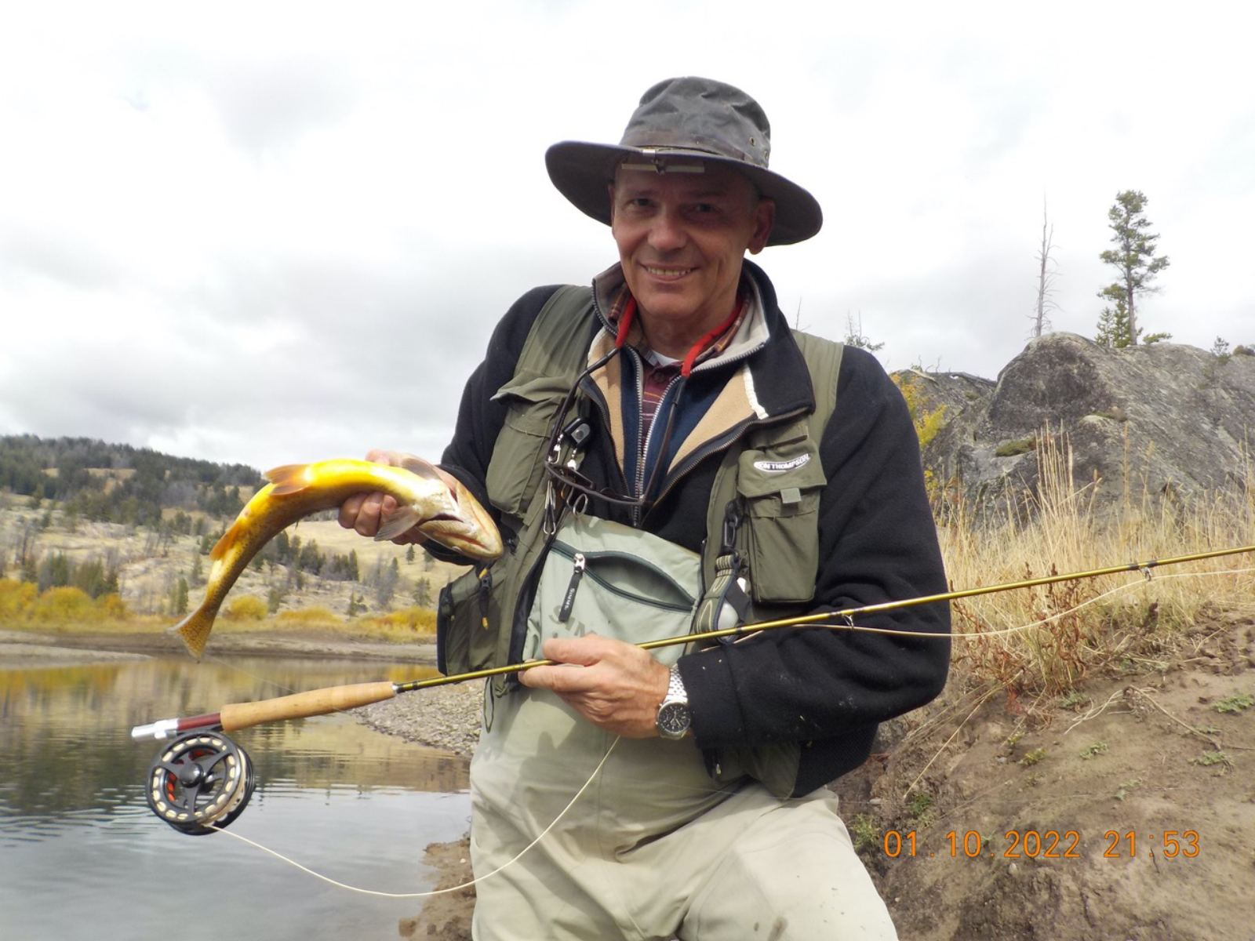
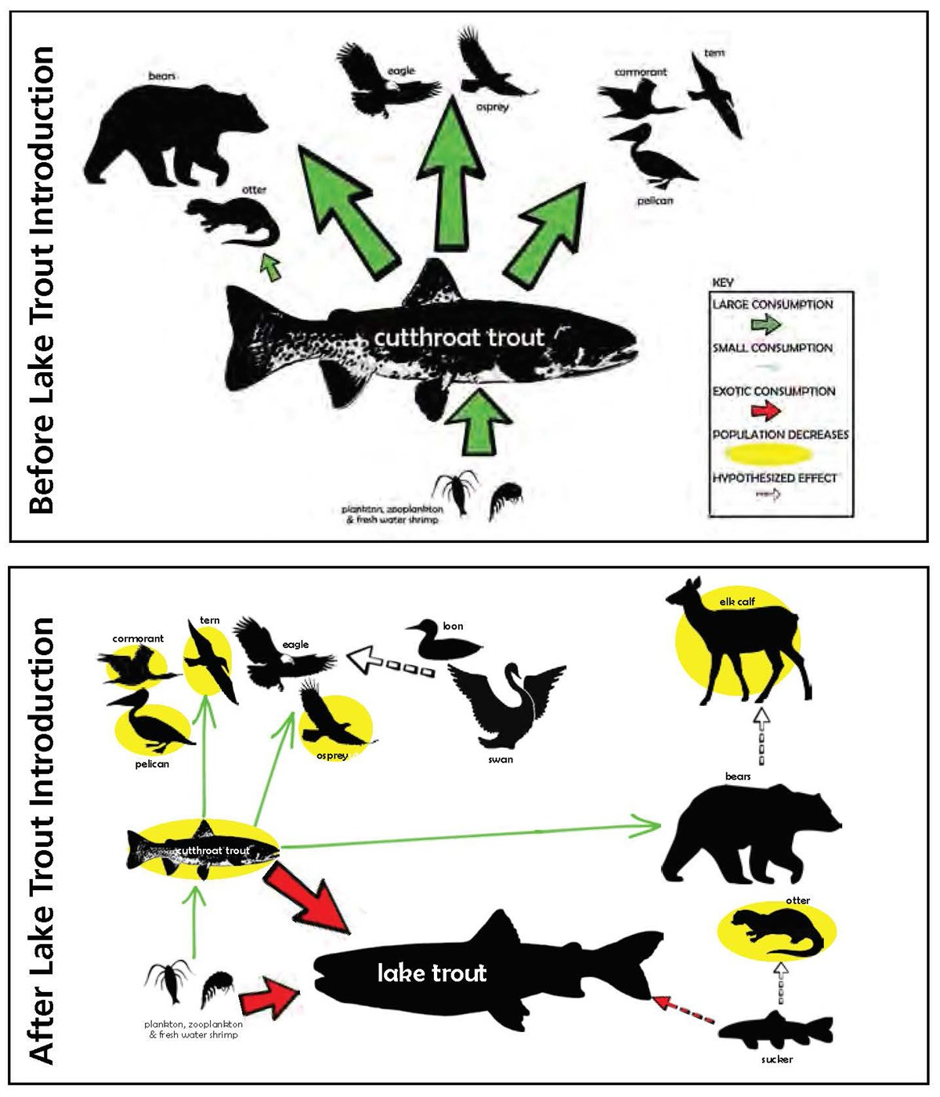
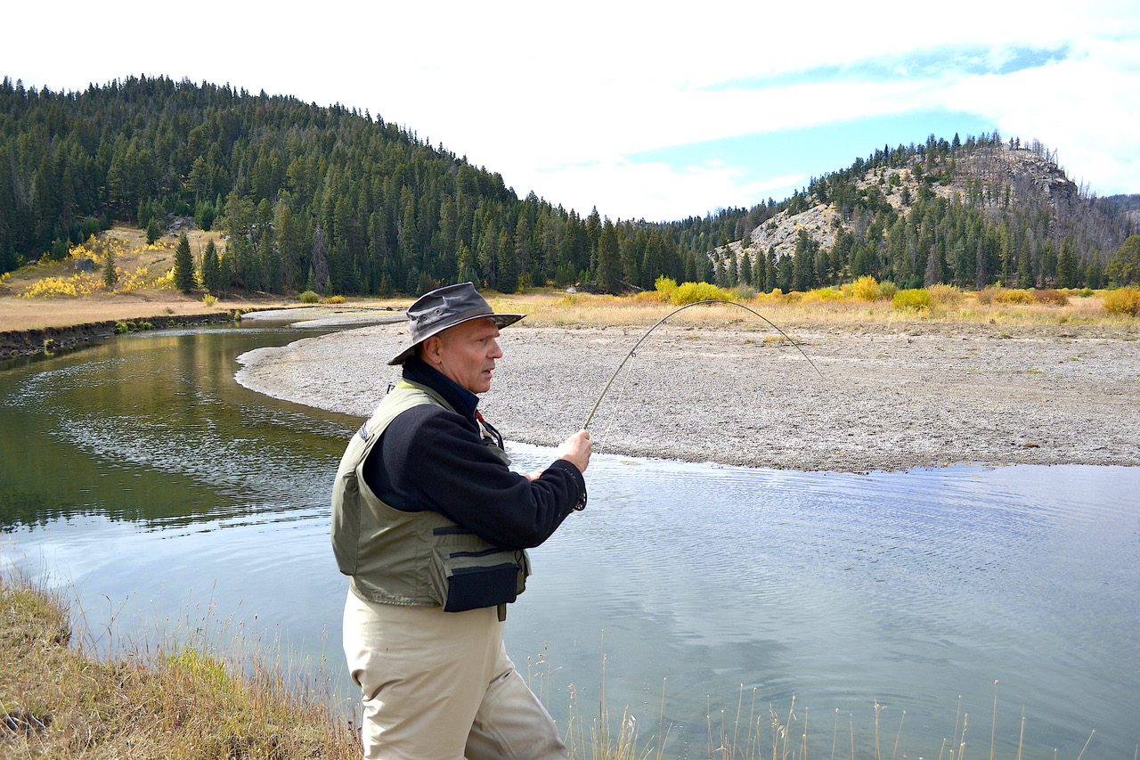
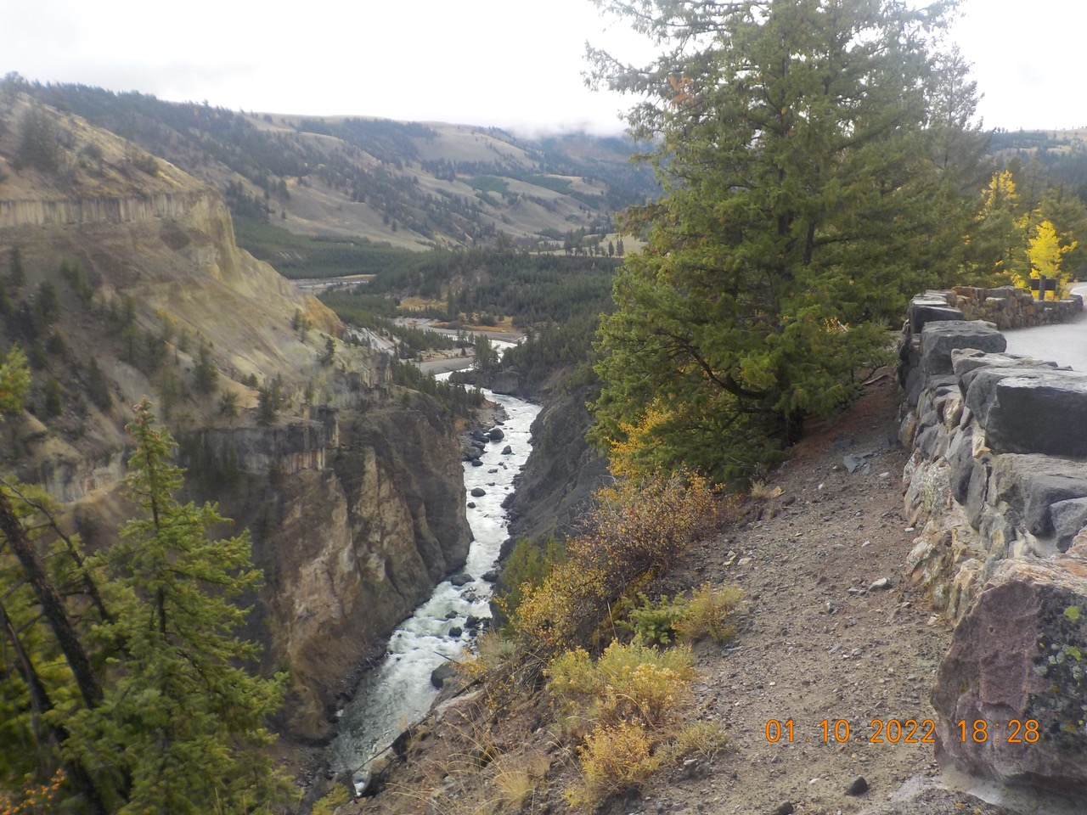
Example of Yellowstone National park
50,000 of the park’s four million visitors fish each year
fishing in Yellowstone can help support preservation of native species
Obligation - filling a Volunteer Angler Report (VAR) report – for data collection
Tackle, Lure, and Hook Restrictions
  one rod which must be attended at all times and used for angling only
  Barbless hook (to reduce handling time and injury)
  flies – only organic material allowed -feathers
  lead-free artificial lures
  Attractants are illegal
In native trout conservation area: Native fish – release; No possession limit for nonnative fish - must be killed—it is illegal to release them alive.
Non-native Trout Tolerance Area - Native fish – release; Possession limits exist for nonnative fish in this area. An angler must cease fishing in the area immediately after filling the possession limit.
Volunteer fly fishers have promoted an understanding of the Yellowstone Lake ecosystem restoration program and generated greater awareness of the current issues facing Yellowstone’s native fish.
Koel et al. 2017

Slide 13
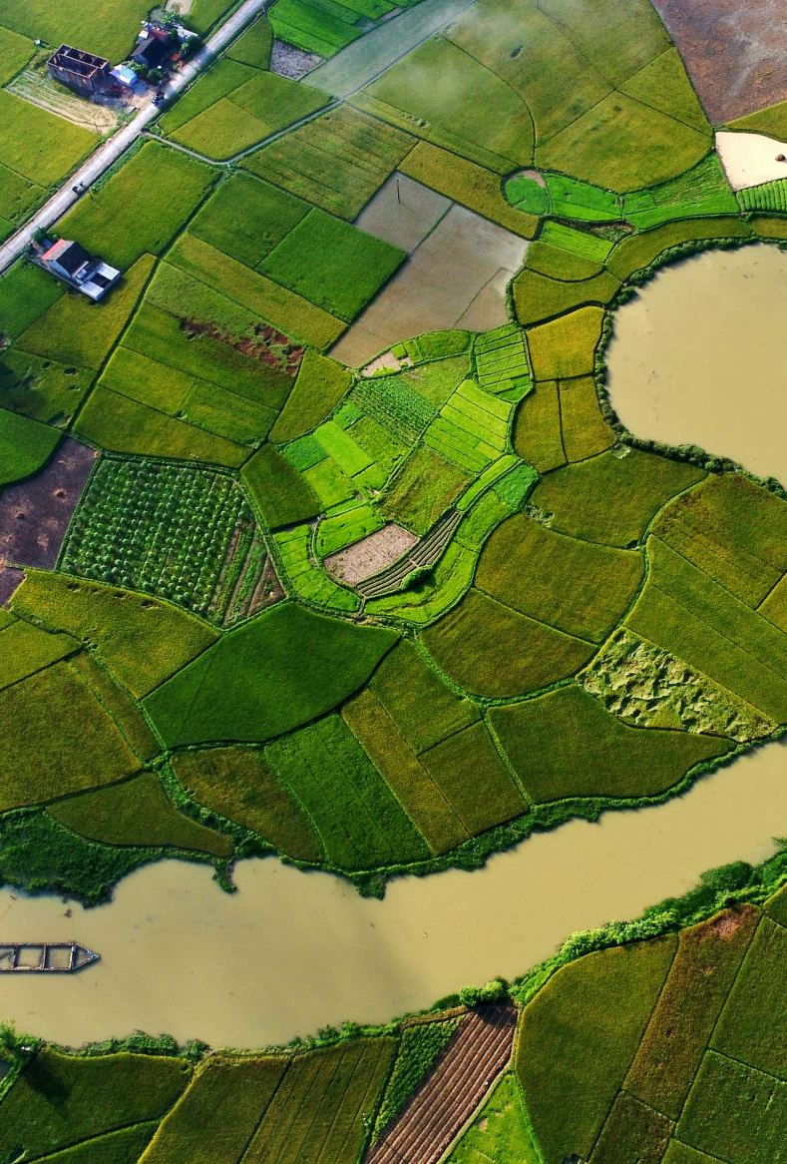
Conclusions
in riverine systems -freshwater protected areas even small reserve sizes has positive effects on fish biomass and fish conservation
In lakes (including small waterbodies)- even small-scale protection can generate relevant conservation outcomes
angling and protected areas - can be integrated on the same systems
Recreational fishery with guided management may have positive effect on strictly protected areas
economics, sociocultural issues, political considerations and enforcement components have to be considered and coordinated

Slide 14
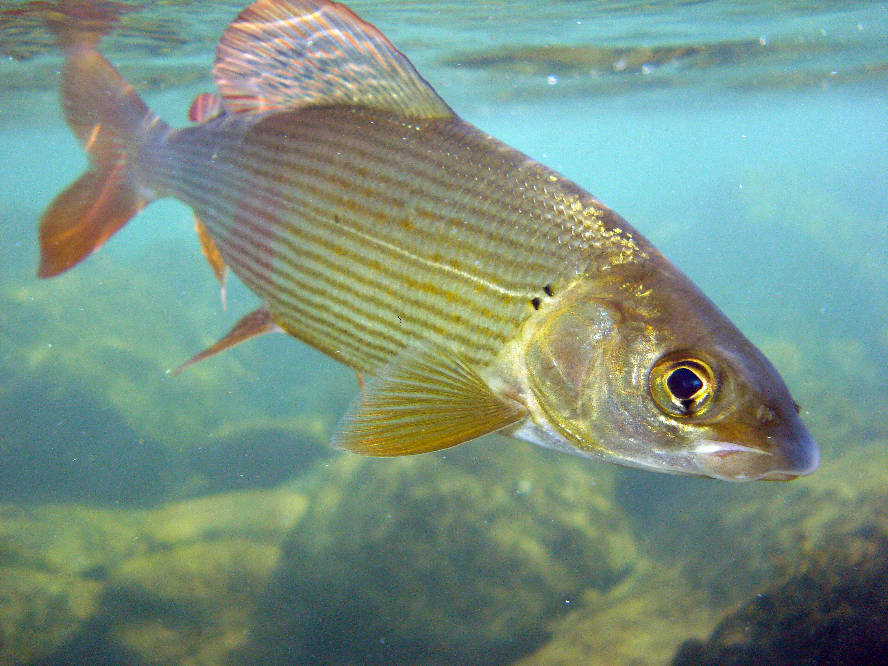
Thank you for your attention

